Slide 1


Great Idea:
The Sun and other stars use nuclear fusion reactions to convert mass into energy. Eventually, when a star’s nuclear fuel is depleted, the star must burn out.

Slide 2
Chapter Outline
The Nature of Stars
The Anatomy of Stars
The Variety of Stars
The Life Cycles of Stars

Slide 3
The Nature of Stars

Slide 4
The Nature of Stars
Astronomy
Oldest science
Star
Fusion reactor in space
Ball of gas
All stars have a beginning and an ending

Slide 5
The Night Sky
Figure 14-1

Slide 6
Measuring the Stars with Telescopes and Satellites
Electromagnetic radiation
Measurement of photons
Wavelength
Intensity
Direction
Variation

Slide 7
Schematic Drawings of Telescopes
Figure 14-2 Schematic diagram of telescopes

Slide 8
Keck Telescopes
Figure 14-3a Keck telescopes in Hawaii. Currently the world’s largest.

Slide 9
Magellan Telescope
Figure 14-4-Image of the Giant Magellan Telescope

Slide 10
Orbiting Observatories
Great Observatories Program
Hubble Space Telescope
Spitzer Infrared Space Telescope
Chandra X-Ray Observatory

Slide 11
The Hubble Space Telescope
Figure 14-5 The Hubble Space telescope.

Slide 12
The Anatomy of Stars

Slide 13
The Structure of the Sun
Structure
Stellar core
Convection zone
Photosphere
Chromosphere
Corona
Solar wind
Stream of particles

Slide 14
The Surface of the Sun
Figure 14-6 NASA image of surface of sun showing magnetic fields.

Slide 15
The Sun's Chromosphere and Corona
Figure 14-7 Image of the Sun’s chromosphere and corona (only visible during a total eclipse)

Slide 16
Earth’s Magnetic Field
Figure 14-8a image of the magnetic field lines of the earth and the effects of solar wind.

Slide 17
Northern Lights
Figure 14-8b. Image of the Northern Lights-these results from interaction of the solar wind with earth’s magnetic field

Slide 18
The Science of Life
Why is the visible spectrum visible?
Figure 14-9: Image of the peak energy output of the sun in the visible spectrum.

Slide 19
The Sun’s Energy Source: Fusion
Sun’s energy source
Historical
Current
Hydrogen

Slide 20
Fusion on the Sun – cont.
Fusion
3-steps-hydrogen burning
P + P → D + e⁺ + neutrino + energy
D + P → ³He + photon + energy
³He + ³He→ ⁴He + 2protons + photon + energy
Life expectancy
11 billion years

Slide 21
The Ongoing Process of Science
Super neutrino detector
Figure 14-10: Image of the Super Kamiokande neutrino detector.

Slide 22
The IceCube Lab
Figure 14-11: Image of Ice Cube lab which has detectors for light given off by interacting neutrinos.

Slide 23
The Variety of Stars

Slide 24
The Variety of Stars
Differences
Color
Brightness
Distance
Absolute brightness
Energy output
Luminosity
Apparent brightness
Behavior
Total mass
Age

Slide 25
The Astronomical Distance Scale
Time
Light-years
Measurement
Triangulation
Cepheid variable

Slide 26
The Triangulation of Stellar Distances
Figure 14-12: Image showing how to determine the distance to a planet using triangulation.

Slide 27
Cannon and Leavitt
Figure 14-13: Image of Henrietta Leavitt and Annie Cannon, astronomers who demonstrated that Cepheid variable starts undergo a brightening and dimming cycle with regular periodicity. This permitted the determination of the total amount of energy emitted by the star which when compared to the amount of energy detected on earth allowed for the determination of the distance to the star. Cepheid variable starts were first observed in the constellation Cepheus.

Slide 28
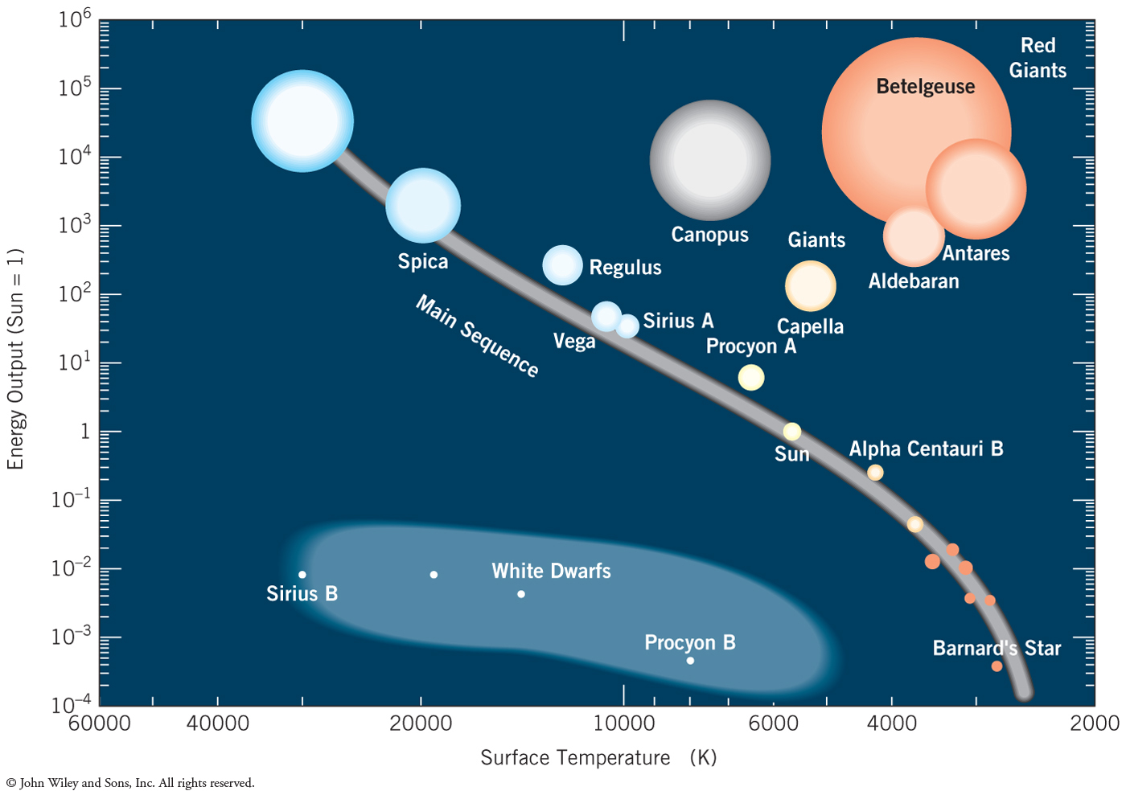
The Hertzsprung-Russel Diagram
Star groupings
Main-sequence stars
Red giants
White dwarfs

Slide 29
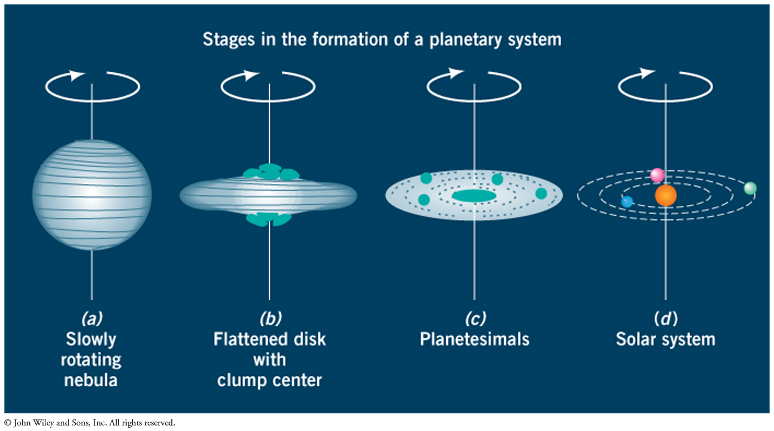
Formation of a Planetary System

Slide 30
Chapter 15: Cosmology & The Big Bang Theory

Slide 31
Chapter Outline
Edwin Hubble and the Discovery of Galaxies
The Redshift and Hubble’s Law
The Large-Scale Structure of the Universe
The Evolution of the Universe
What Is the Universe Made Of?

Slide 32
Edwin Hubble and the Discovery of Galaxies

Slide 33
The Nebula Debate
Nebulae
Cloud-like objects
Debate over distance of nebulae

Slide 34
Hubble
Largest telescope
Used Cepheid variable stars to measure distance to nebula
Galaxies
Hubble discovered universe is billions of galaxies
Cosmology

Slide 35
Edwin Hubble
Figure 15-1 Image of Edwin Hubble at work at the Mt Wilson telescope.

Slide 36
Kinds of Galaxies
Spiral
Elliptical
Irregular and dwarf
Active galaxies
Quasars

Slide 37
A Map of the Milky Way
Figure 15-2: Image of spiral galaxy.

Slide 38
A Typical Spiral Galaxy
Figrue 15-3: Image of a spiral galazy from the Hubble Space Telescope (HST).

Slide 39
A Typical Elliptical Galaxy
Figure 15-4: Example of a elliptical galazy called M84 in the Virgo constellation.

Slide 40
Deep-Field Image of Galaxies
Figure 15-5: Deep field space image. This image of apparently empty sky was shown to have thousands of starts through long exposures taken by the HST.

Slide 41
The Redshift and Hubble’s Law

Slide 42
The Redshift and Hubble’s Law
Redshift
Hubble’s Law
The more distant a galaxy, the faster it recedes
V = H x d
H is Hubble’s constant a figure now agreed to be 70km/s/Mpc
Hubble’s constant provides an estimate of the age of the universe (about 14 billion years)
Mpc= megaparsec 3.3 billion light years (or 3.086 x 10¹⁹km)
1 light year is 9.4607 × 10¹² km (literally the distance light travels in one year)

Slide 43
Photographs of Galaxies and Their Spectra
Figure 15-6: Image illustrating the red shift association with a galaxy receding.

Slide 44
Red Shift and Distance
The redshift is defined as the transition of electromagnetic radiation toward the less energetic (red) end of the spectrum when a light source is moving away from the observer.
Light from distant galaxies has distinct spectral features depending upon the atoms in the gases near these galaxies. These characteristic spectra are shifted toward the red end of the spectrum in a manner similar to the Doppler effect
http://hyperphysics.phy-astr.gsu.edu/hbase/Astro/redshf.html

Slide 45
Illustration of Hubble Expansion
Figure 15-7: Cartoon showing the concept of the Hubble expansion whereby more distant galaxies recede more quickly than do nearer ones.

Slide 46
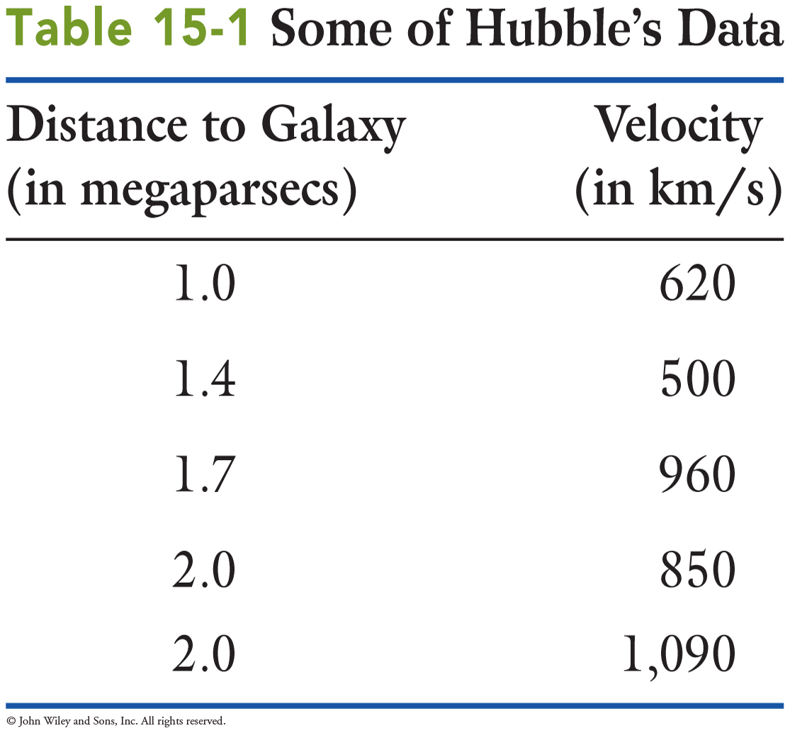
Science by the Numbers
Analyzing Hubble data

Slide 47
Distance versus Velocity Relationship
Figre 15-8: Image showing a graph with Hubble’s original data illustrating the linear relationship between distance and velocity of recession.

Slide 48
The Large-Scale Structure of the Universe

Slide 49
The Big Bang
Big Bang
The universe began at a specific time in the past, and it has been expanding ever since

Slide 50
The Large-Scale Structure of the Universe
The Local Group
Milky Way, Andromeda Galaxy, and others
Groups, clusters, superclusters
Voids

Slide 51
Distribution of Galaxies in Space
Figure 15-9: Digital sky survey illustration showing distribution of galaxies in space.

Slide 52
Apache Point Observatory – New Mexico, U.S.
Figure 15-10: Apache Point observatory where the data from Figure 15-9 were gathered.

Slide 53
Useful Analogies
Raisin-Bread Dough Analogy
Expanding Balloon Analogy
Figurew 15-11 and 15-12: Illustrations of the raisin bread dough and expanding balloon analogies to explain the universal expansion postulated by Hubble’s data.

Slide 54
Evidence for the Big Bang
The universal expansion
Steady-state universe
The cosmic microwave background
Penzias and Wilson
End of steady-state theory
The abundance of light elements
Hydrogen, helium, and lithium

Slide 55
Cosmic Background Explorer
Figure 15-13a Image of the Cosmic Explorer which made the first measurements of the microwave background radiation of earth and space.

Slide 56
Map of Microwave Radiation
Figure 15-13b Image of microwave radiation of entire sky. Microwave radiation is not uniform but rather is found in clumps.

Slide 57
The Evolution of the Universe

Slide 58
Some General Characteristics of an Expanding Universe
All matter heats when compressed
Hot big bang
Freezings
Changes in universe

Slide 59
The Sequence of “Freezings”
Figure 15-14: Image of the sequence of freezings after the big bang.

Slide 60
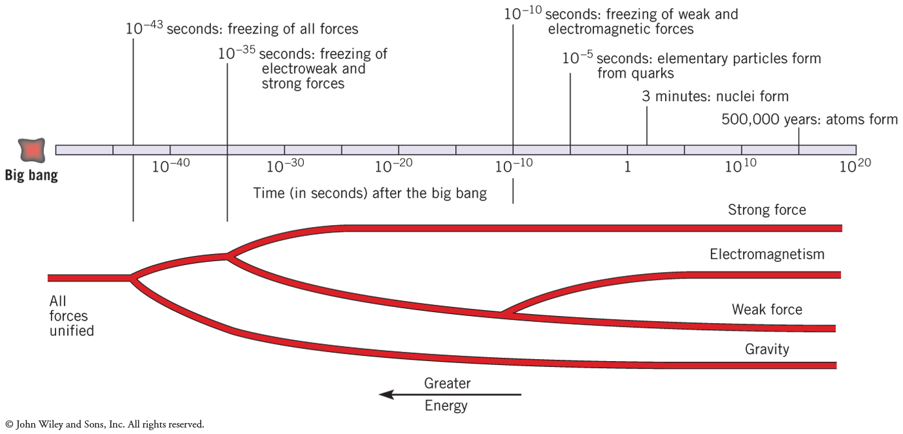
10^{–43} Second: The Freezing of All Forces
Two fundamental forces
Gravity
Strong-electroweak force
Limit of our knowledge of universe

Slide 61
10^{–35} Second: The Freezing of the Electroweak and Strong Forces
Three fundamental forces
The elimination of antimatter
Galaxy is ordinary matter
Why?
Leftover protons
Inflation
Short rapid expansion
Common temperature

Slide 62
Evolution of the Universe through the Succession of Freezings
Figure 15-15 Evolution of the universe through the various freezings.

Slide 63
10^{–10} Second: The Freezing of the Weak and Electromagnetic Forces
Four fundamental forces
Particle accelerators
Reproduce from here forward
Experimental evidence for evolution of universe

Slide 64
10^{–5} Second: The Freezing of Elementary Particles
Elementary particles formed
Prior were fundamental particles
Quarks and leptons
After
Hadrons and leptons
Hadrons are particles which include protons and neutrons made up of quarks (subject to the strong force)
Leptons are particles like electrons muons and neutrino participate in weak and electromagnetic but not the strong force.

Slide 65
Three Minutes: The Freezing of Nuclei
Nuclei become stable
Only nuclei of H, He and Li
Plasma

Slide 66
Before One Million Years: The Freezing of Atoms
Formation of atoms
Radiation released
Cosmic microwave background
Galaxy problem

Slide 67
What Is the Universe Made Of?

Slide 68
Dark Matter and Ripples at the Beginning of Time
Dark Matter
Measure gravitational effects
Hydrogen atoms
Formation of dark matter (questions to be answered)
Before atoms formed?
Formed clumps?
Ripples at the beginning of time
Collection of luminous matter

Slide 69
Discovery of Dark Matter
Figure 15-17: Graph showing the motion predicted for starts as you move outwards from the centre fo the galaxy. The failure to observe the “Kepler rotation” was attributed to gravity from dark matter and supports the existence of dark matter.

Slide 70
The End of the Universe
Open, closed or flat universe
Current data
Mass of universe
Open universe
Type Ia supernova
Dark Energy
74% of universe’s mass

Slide 71
Dark Energy
Figure 15-18: Pie chart illustrating the composition of the universe. Note that ordinary matter constitutes only about 4% of all matter.

Slide 72
Future
Depends on dark energy
“Big Rip”

Slide 73
Copyright 2013 John Wiley & Sons, Inc.
All rights reserved. Reproduction or translation of this work beyond that permitted in section 117 of the 1976 United States Copyright Act without express permission of the copyright owner is unlawful. Request for further information should be addressed to the Permissions Department, John Wiley & Sons, Inc. The purchaser may make back-up copies for his/her own use only and not for distribution or resale. The Publisher assumes no responsibility for errors, omissions, or damages caused by the use of these programs or from the use of the information herein.

